Slide 1

INTERACTIVE GAMING SUITE USING C LANGUAGE
(Batch-C1)
Foundations of Programming-CSE10010
Mini Project Presentation 2025-26
Aditya Awale (1262253318), Arham Gadiya (1262252447), Dhruv Bapat (1262251812), Aarush Majumdar (1262252187),
Nandan Pattanshetti (1262252466)
Guided By:
Dr. Renuka Mane

Slide 2
Content
Introduction and Motivation
Problem Statement and Objectives
Individual Contribution
Summary of Literature Survey
Proposed System
Hardware and Software Requirements
Implementation and Experimental Setup
Results and Conclusions
References

Slide 3
Problem Statement and Objectives
Problem Statement:
Traditional programming education struggles to engage students. Logic-based games bridge the gap between theoretical concepts and practical application, making learning interactive and enjoyable.
Objectives:
To develop a user-friendly web application using modern technologies.
To provide an interactive platform where users can access features easily.
To ensure fast performance and smooth navigation.
To design a simple and attractive interface for better user experience.
To demonstrate the use of web development tools and frameworks (like frontend + backend integration).

Slide 4
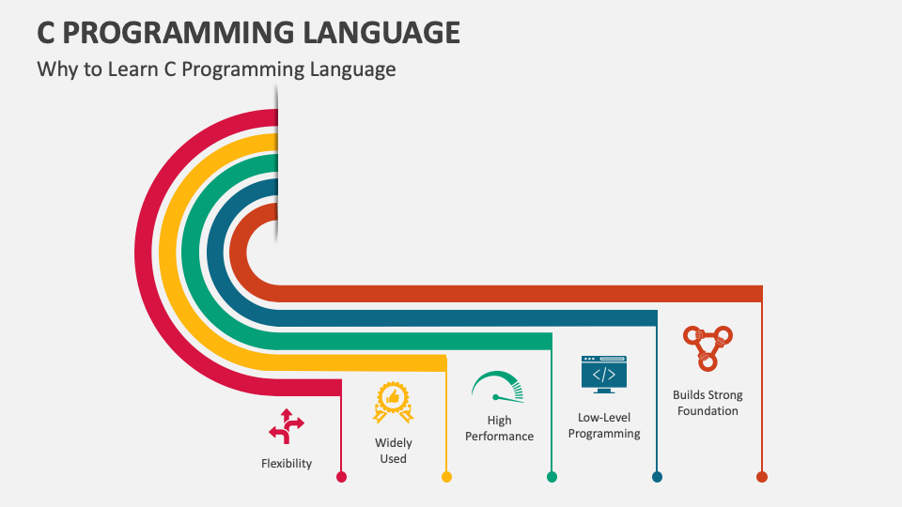
Introduction and Motivation
Why C Language?
Flexibility – Used for system and application development.
Widely Used – Foundation for many modern languages.
High Performance – Fast and efficient execution.
Low-Level Access – Direct control over memory.
Strong Foundation – Builds core programming skills.

Slide 5
Individual Contribution
Name | Work (Report/Presentation/Algorithm Design/Implementation)
Aditya Awale | Tetris Game
Arham Gadiya | Tic-Tac-Toe Game
Dhruv Bapat | Minesweeper
Aarush Majumdar | Blackjack and Application control
Nandan Pattanshetti | Trial By Combat

Slide 6
Summary of Literature Survey
Paper Ref. | Title of Paper | Method Used | How is it useful for your project
Ref[1] | Browser Game Engines Survey | HTML5, Canvas, WebGL | Understanding core web game technologies.
Ref[2] | React.js for Real-Time Games | Component-based design | Implementing efficient UI and state updates.
Ref[3] | Card Game Simulation | Monte Carlo Simulation | Testing game strategies via simulation.
Ref[4] | Responsive Web Design | CSS Grid, Flexbox | Ensuring UI adapts to all screen sizes.

Slide 7
Paper Ref. (as per order of references) | Title of Paper | Method Used | How is it useful for your project
Ref[5] | JS Game Loops | requestAnimationFrame | Optimizing frame rates and performance.
Ref[6] | Multiplayer Architectures | WebSockets, REST | Designing low-latency networking.
Ref[7] | Game UX Design | User Testing, Heuristics | Enhancing engagement via intuitive design.
Ref[8] | CSS Animations | Keyframes, Transitions | Lightweight UI feedback and effects.
Ref[9] | Python Terminal Games | OOP, Event-driven | Structuring logic with object principles.
Ref[10] | Combinatorial Game Theory | Minimax, Game Trees | Core AI logic for turn-based games.

Slide 8
Proposed System
Arcadex is a multi-language, component-based gaming suite deployed on Vercel. It utilizes a React (JSX) shell for modular routing, allowing independent game components to handle their own state and rendering. The architecture integrates JavaScript for browser-based logic, Python for card simulations, and C for performance-critical combat mechanics. Key technical implementations include BFS flood-fill algorithms for grid interactions and frame-based collision systems for real-time gameplay.

Slide 9
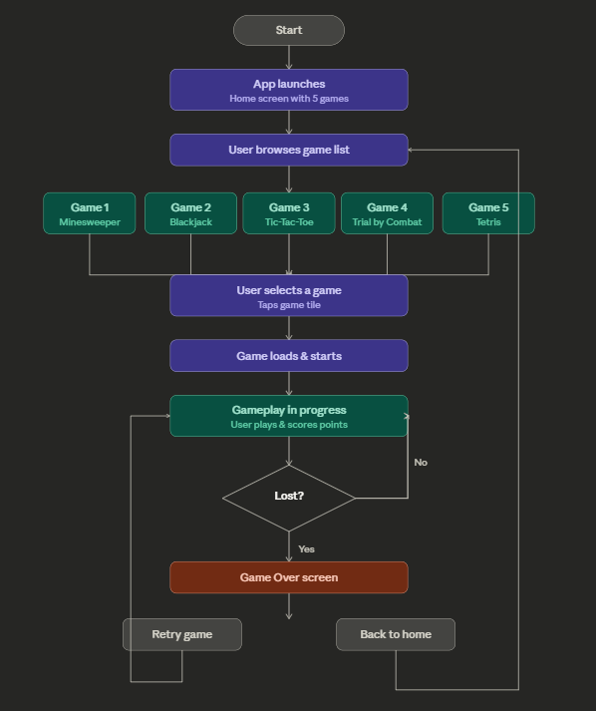
Flowchart
afadadff fa

Slide 10
Hardware Requirements
Hardware | Model | Justification w.r.t project
Processor (CPU) | Intel Core i5 10th Gen | Required for efficient compilation and execution of React-based applications and C/Python logic simultaneous.
RAM | 8 GB DDR4 | Ensures smooth multitasking, especially when running development environments like Visual Studio Code.
Graphics Card (GPU) | Integrated Graphics | Since Arcadex uses lightweight 2D animations and CSS/JS transitions, integrated graphics are sufficient for rendering web games.
Display | Monitor | Allows responsive UI testing and front-end design validation for different aspect ratios.
Operating System | Windows 10 / 11 or macOS Monterey | Provides compatibility with Node.js, Python, C compilers, and modern browsers used in testing the web platform.

Slide 11
Software Requirements
Software | Justification w.r.t project
Frontend Framework | Used to create modular game components and manage state across multiple games in a single web app.
Programming Languages | Multi-language integration: Python for Blackjack logic, C for combat mechanics, JS for UI/game logic.
Frontend Design | Enables cross-browser compatibility and visually consistent UI/UX across all four games.
Web Deployment Platform | Simplifies deployment of React apps with continuous integration and global CDN access.
Version Control | Used for collaborative coding, maintaining version history, and team-based updates.

Slide 12
Implementation and Experimental Setup
This project was implemented and stored in GitHub repository. For the application, the github had it’s own other repository for frontend, backend, javascript was used for making UI design , saving login screen information and python for backend . The games were made in C language.
The setup for this was different laptops and mobile phones so that we could run it on different devices and still run it. It had an multiplayer category as well for 2 players to play within other devices. The app could be shared through links.

Slide 13
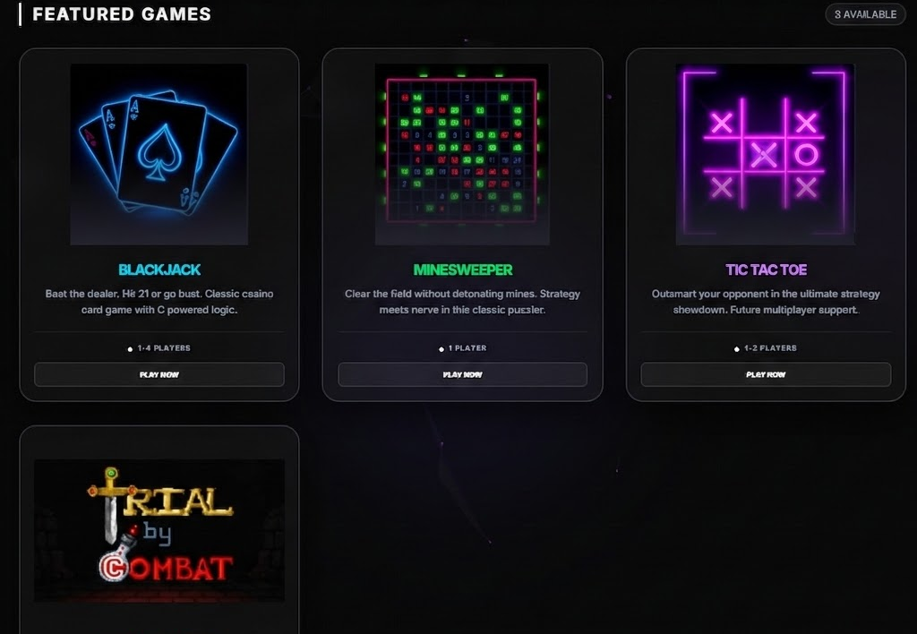
Results
HOME SCREEN -
(Vercel App)

Slide 14
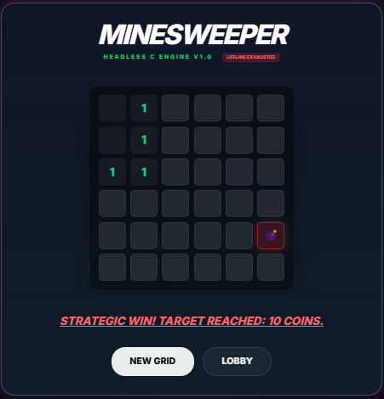
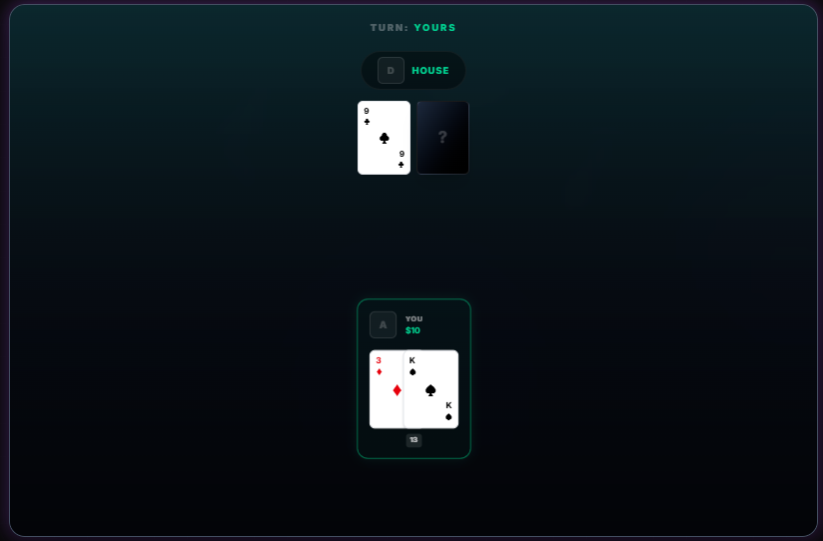
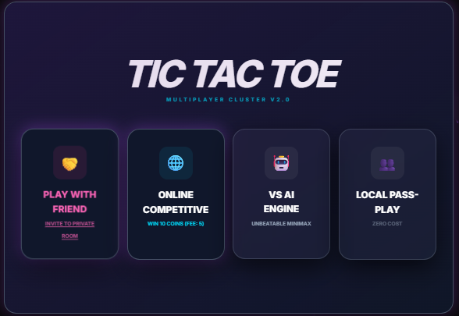
Results
MINESWEEPER BLACKJACK TIC-TAC-TOE

Slide 15
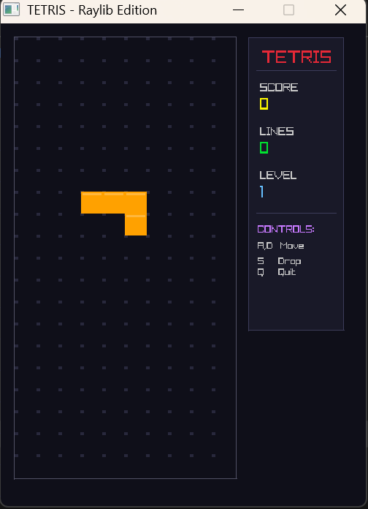
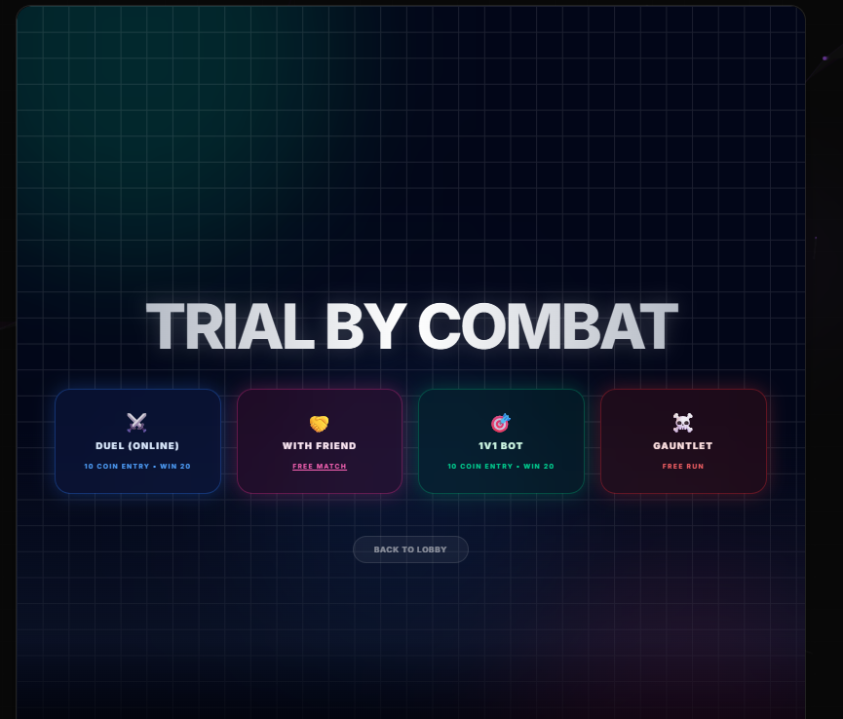
Results
TRIAL-BY-COMBAT TETRIS

Slide 16
Conclusion
The project made using Vercel, features a collection of 5 mini games as our project, each developed by an individual team member. This project shows our ability to design and implement browser games using modern technology. Each game reflects the unique creativity and coding skills of its developer, while the platform as a whole demonstrates our teamwork and ability to integrate multiple projects into a single, seamless experience.
Through this project, we gained hands-on experience in web development, game logic, UI design, and cloud deployment, making Arcade not just a game platform, but a testament to what collaborative effort and innovation can achieve.

Slide 17
References
[1] T. Akenine-Moller, E. Haines, and N. Hoffman, Real-Time Rendering, 4th ed. CRC Press, 2018.
[2] S. Russell and P. Norvig, Artificial Intelligence: A Modern Approach, 4th ed. Pearson, 2020.
[3] MDN Web Docs, 'HTML5 Canvas API,' Mozilla Developer Network. [Online]. Available: https://developer.mozilla.org/en-US/docs/Web/API/Canvas_API
[4] React Official Documentation, 'React - A JavaScript library for building user interfaces.' [Online]. Available: https://react.dev
[5] Vercel, 'Vercel - Deploy web projects with zero configuration.' [Online]. Available: https://vercel.com
[6] W3C, 'CSS Animations Level 1,' W3C Recommendation, 2018. [Online]. Available: https://www.w3.org/TR/css-animations-1/
[7] R. Sedgewick and K. Wayne, Algorithms, 4th ed. Addison-Wesley, 2011.
[8] T. H. Cormen, C. E. Leiserson, R. L. Rivest, and C. Stein, Introduction to Algorithms, 3rd ed. MIT Press, 2009.
[9] Arcadex Gaming Suite. [Online]. Available: https://arcadexmit.vercel.app

